Slide 1

Global pizza sales analysis
Pizza sales analysis
Vishal sinha

Slide 2
Objective
Summarize Sales Performance: Highlight overall sales trends by pizza size/category.
Identify Best & Worst Sellers: Showcase the top and least popular products.
Analyze Revenue Contribution: Break down revenue by product size and category.
Present Key KPIs: Show key financial indicators (revenue, profit, order value).
Provide Insights for Decision Making: Offer actionable recommendations based on data.

Slide 3
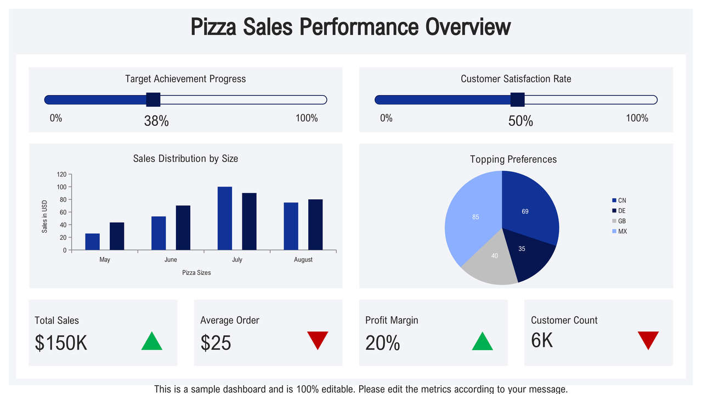

Slide 4
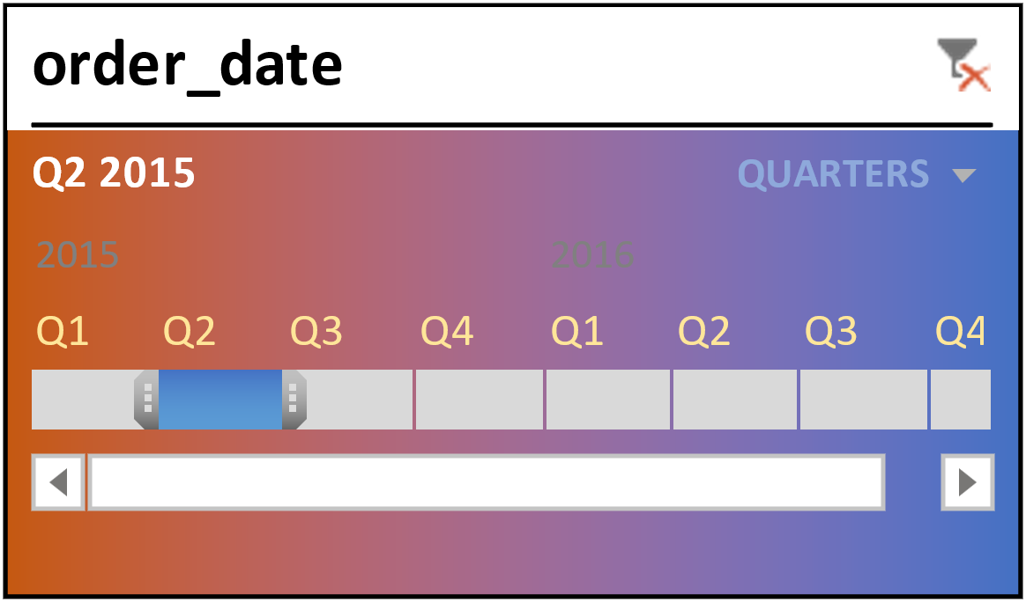
Sales & trends
Sales Trends:
The goal is to identify patterns in pizza sales over time months, seasons, or years,quarter

Slide 5

Using SQL & MS Excel for analysis

Slide 6
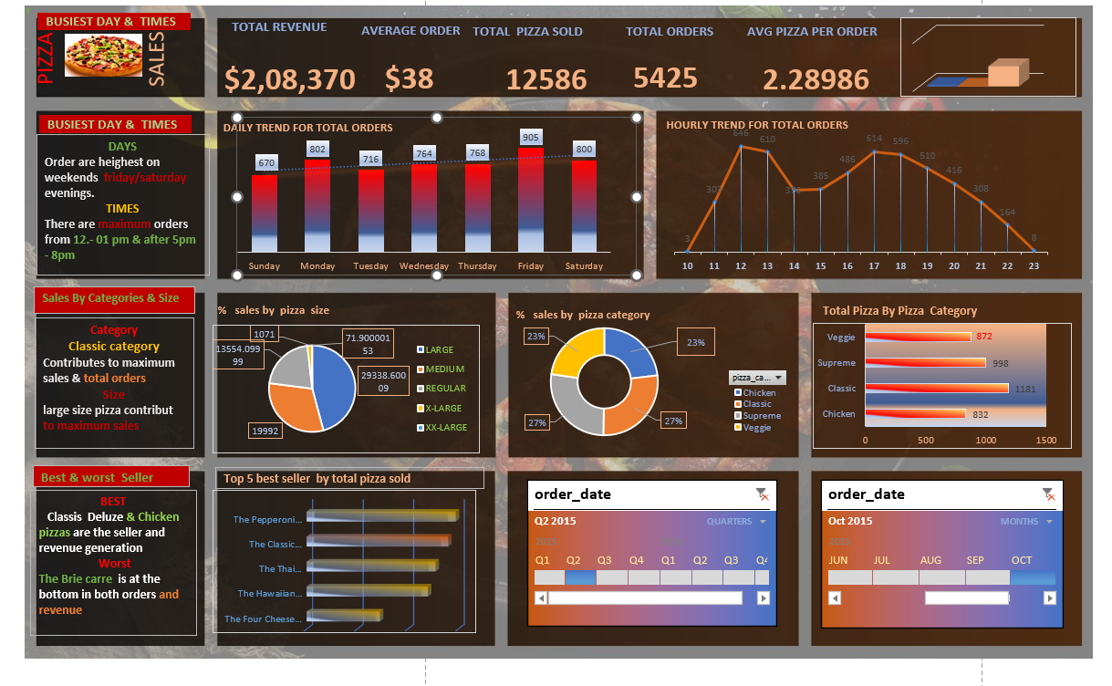
Dashboard
Product A
Analysis
BUSIEST DAY & TIMES
Sales By Categories & Size
Best & worst Seller

Slide 7
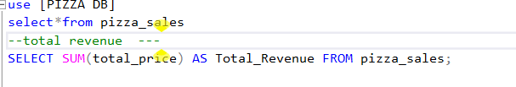

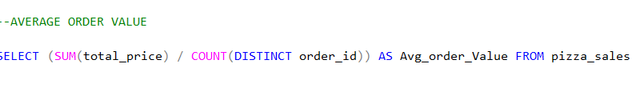

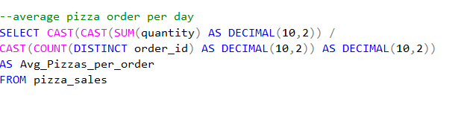
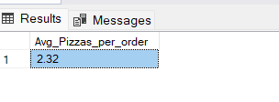


SQL - Queires

Slide 8
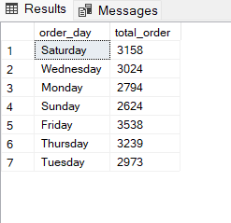
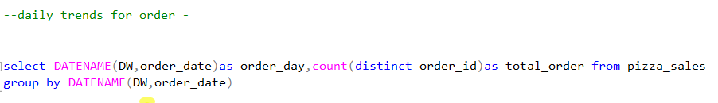
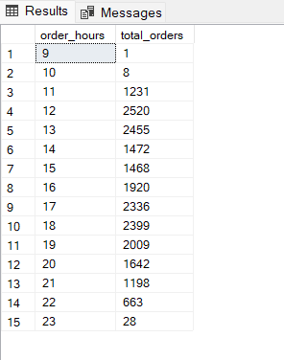
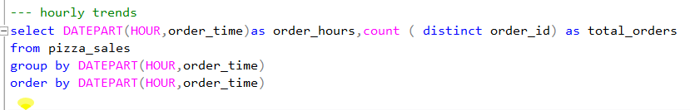
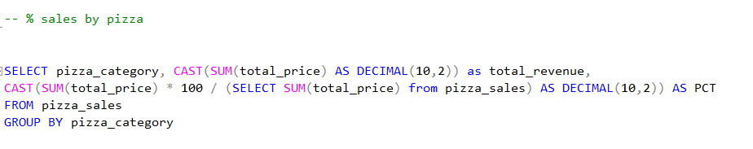
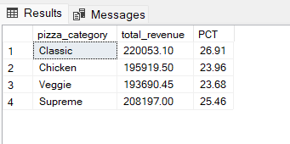

Slide 9
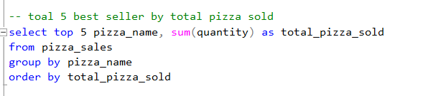
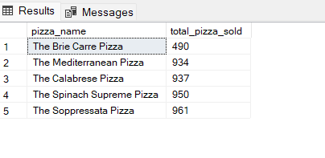
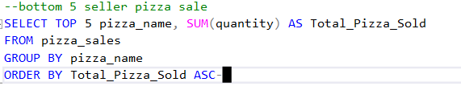
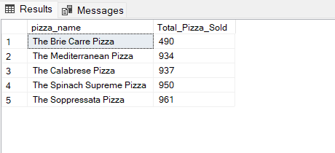

Slide 10
Thank you
Vishal sinha

